Slide 1

Project C
Mattia Siriani - 10571322

Slide 2



Chapters
Trace fitting
JMT Simulation
Results

Slide 3

Fittings
Fittings of the different traces and some distribution functions.

Slide 4
Fittings - Description
In the following pages will be present two graphs for each trace given.
The graphs on the left contains the traces with the following distribution functions:
Uniform
Exponential
Hypo-exponential
Hyper-exponential
Erlang
Gamma
The graphs on the right contains the traces with the best fitting among the distributions used.
If multiple distributions fits the simpler is chosen.
Example: in Test all distribution, except for Uniform, perfectly fits the Trace given, for that reason the exponential distribution function was chosen.

Slide 5
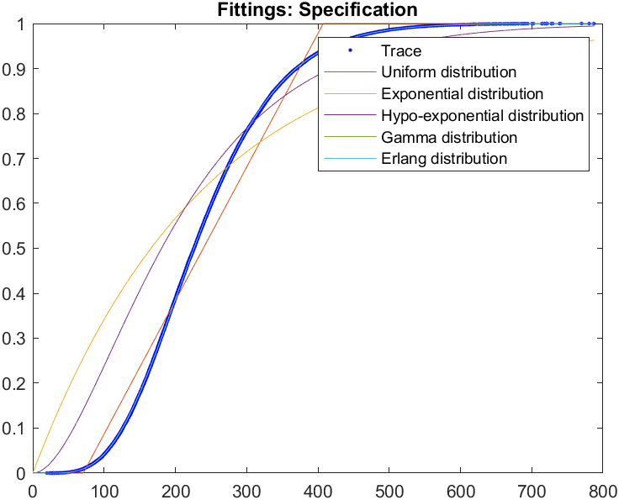
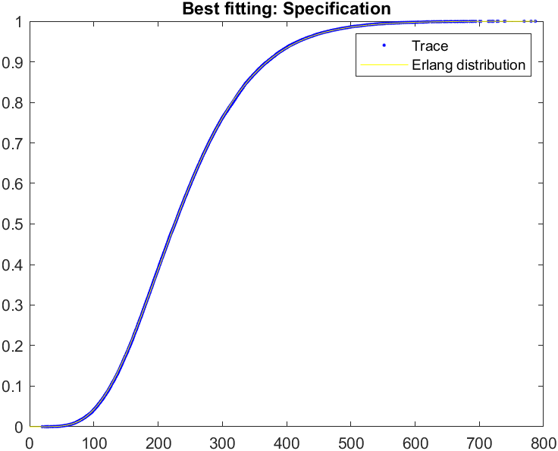
Fittings - Specification

Slide 6
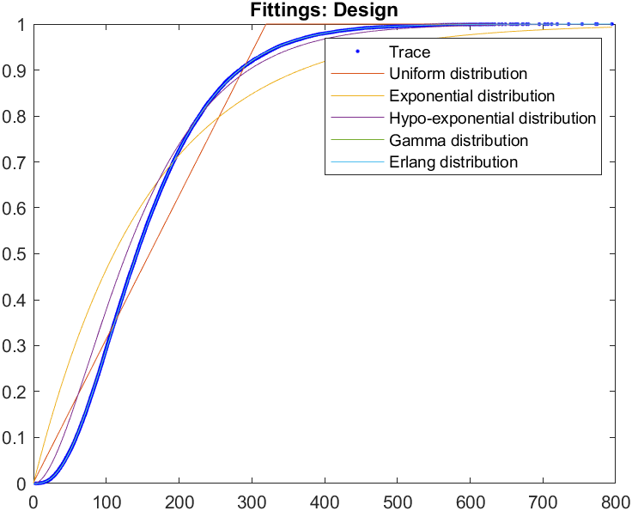
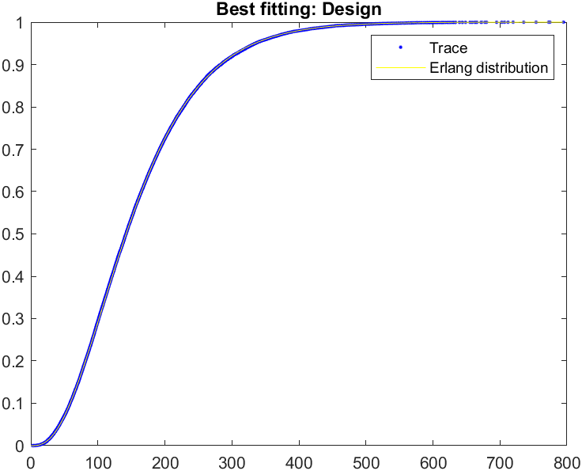
Fittings - Design

Slide 7
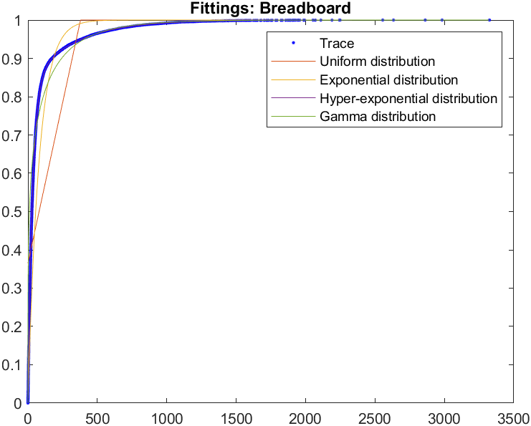
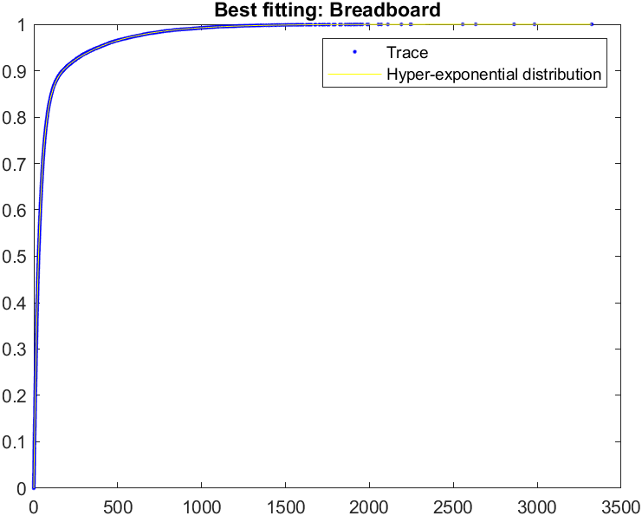
Fittings - Breadboard

Slide 8
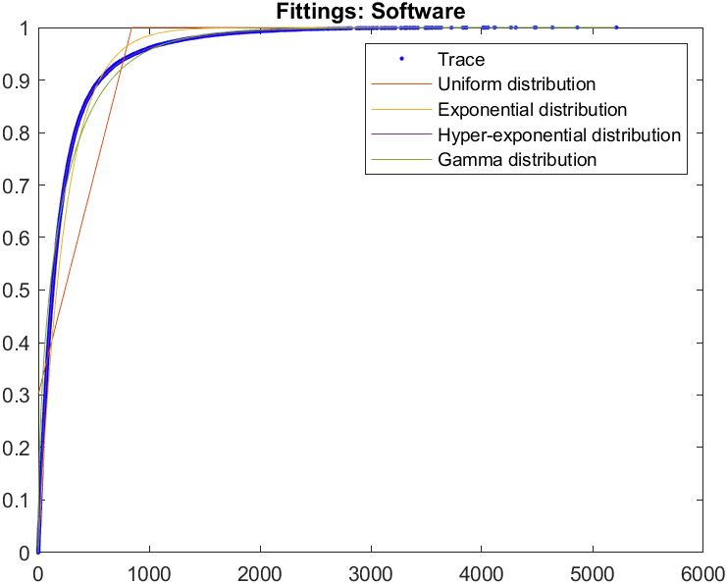
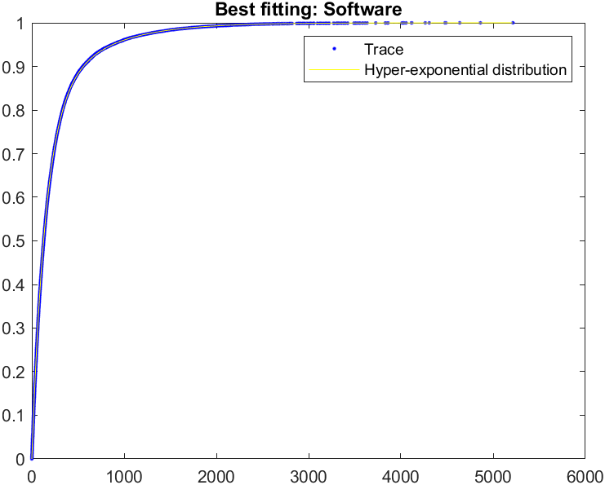
Fittings - Software

Slide 9
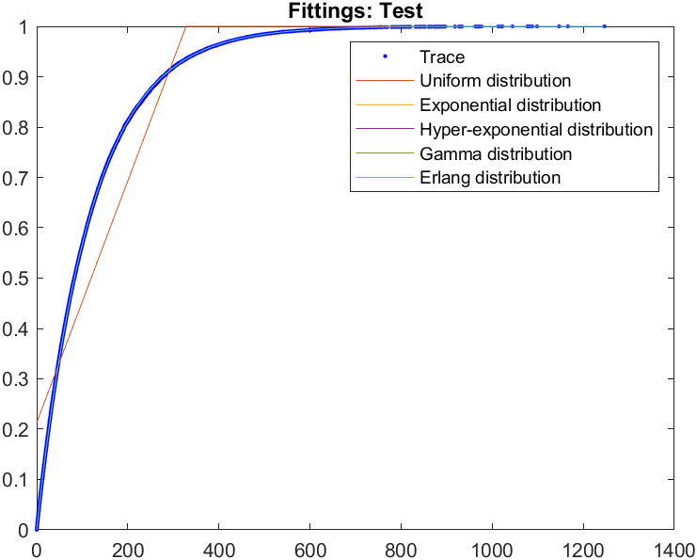
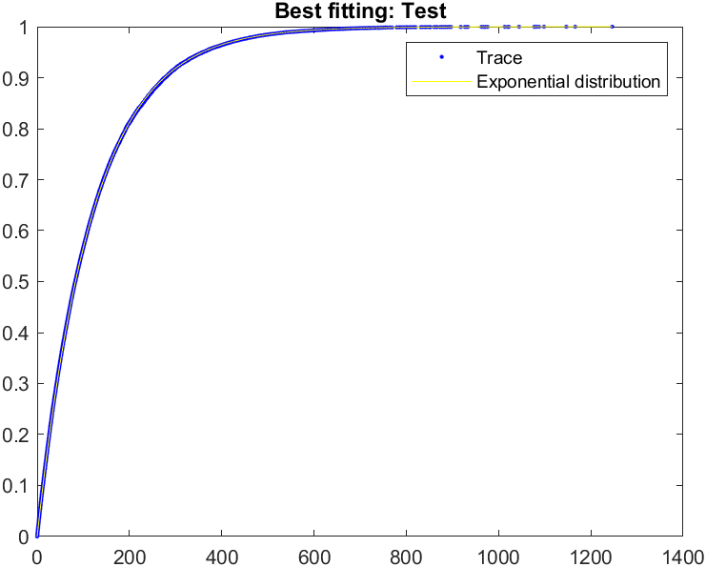
Fittings - Test

Slide 10
JMT Simulation
Simulation of the proposed problem.

Slide 11
JMT Simulation - Description
The simulation has been performed in the following way:
5 different station to define the different departments, with their correspondent Service Time distribution.
Fork/join nodes used to wait before the Test department can start working on the job.
No delay node, since there is no need to wait at the end of the Test department.
The reference station is set on Specification, since it is where the development cycle starts.
Only one class, representing the projects, has being used.
Use of What-if Analysis on the number of projects from 1 to 20, to analyze the performance indices for different number of N.

Slide 12
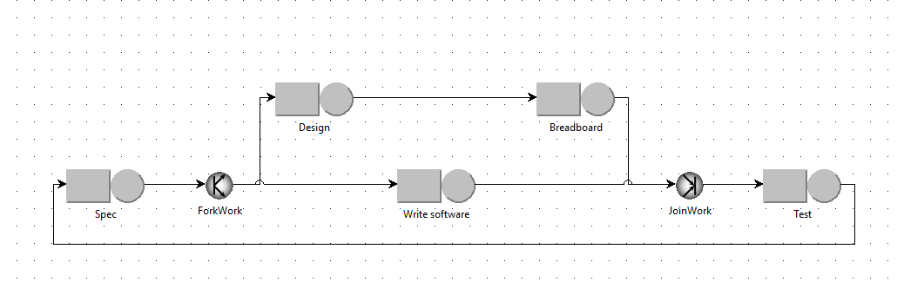
JMT Simulation - JSIMgraph

Slide 13
Results
Results obtained by the simulation.

Slide 14
Result - Data
Tradeoff \ N | 1 | 2 | 3 | 4 | 5
Mean Value | 1.92E-6 | 2.54E-6 | 2.55E-6 | 2.36E-6 | 2.18E-6
Max confidence interval | 1.95E-6 | 2.62E-6 | 2.62E-6 | 2.43E-6 | 2.24E-6
Min confidence interval | 1.90E-6 | 2.47E-6 | 2.47E-6 | 2.30E-6 | 2.12E-6

Slide 15
Results - Description
The previous results were obtained by a JMT simulation, with a confidence interval of 0.99.
From the previous results we can see that the best tradeoff between throughput and project completion time is obtained when N is equal to 3 (also 2 gives good results but lower than 3).

Slide 16
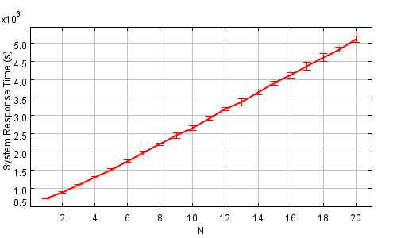
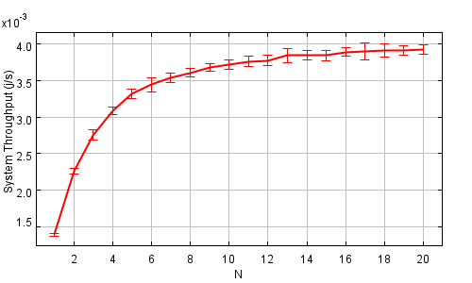
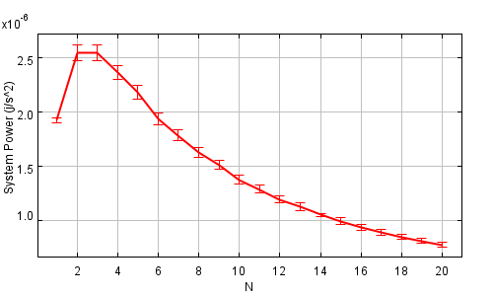
Results – Some graphs
The response times keep increasing as the number of projects increase, with more projects, more time is always required.
The throughput stops increasing when the network is fulfilled.
Therefore, the tradeoff between response time and throughput is higher for lower value of N.

